Slide 1



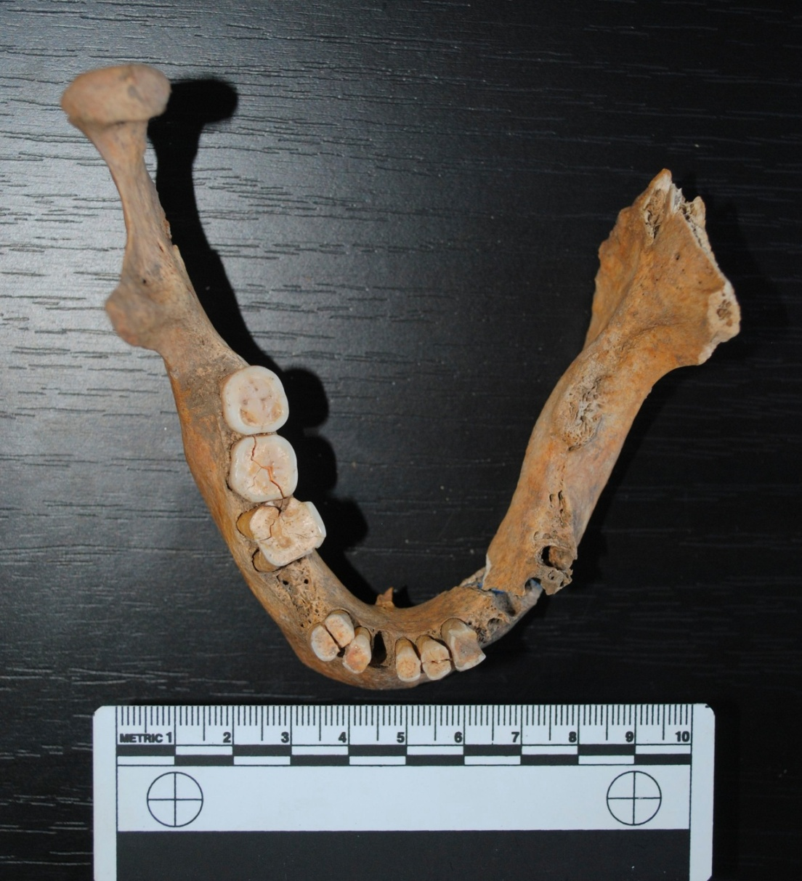
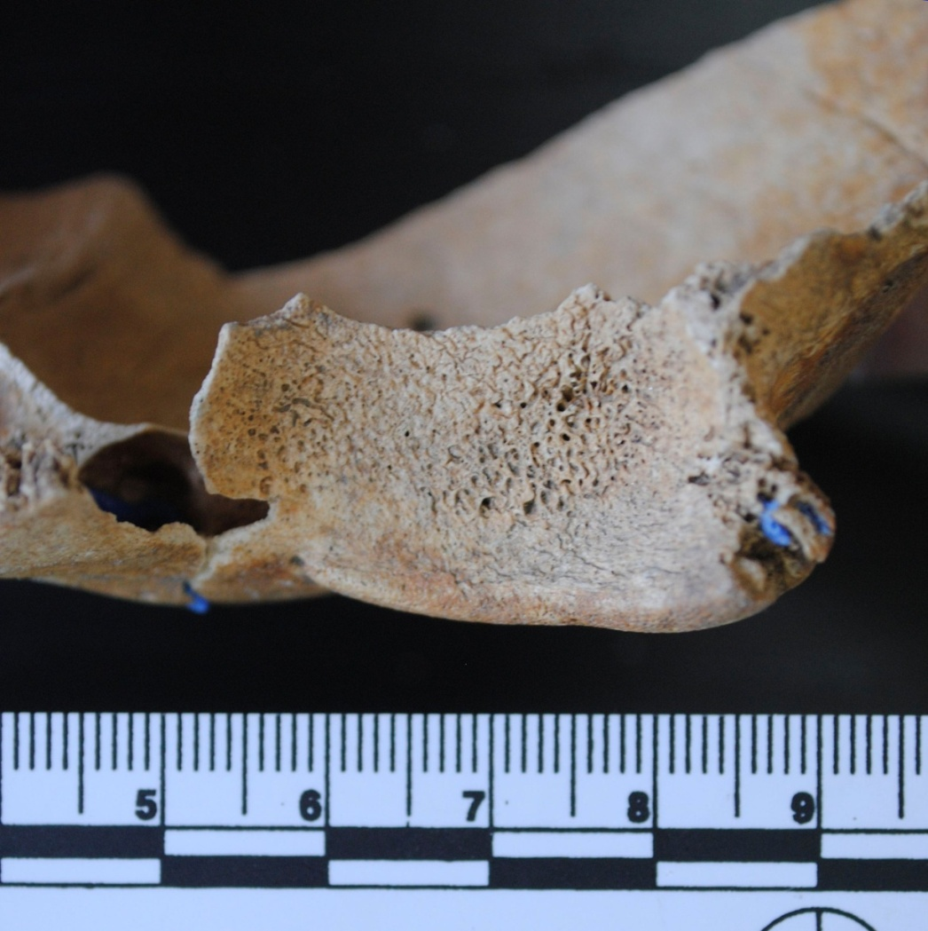
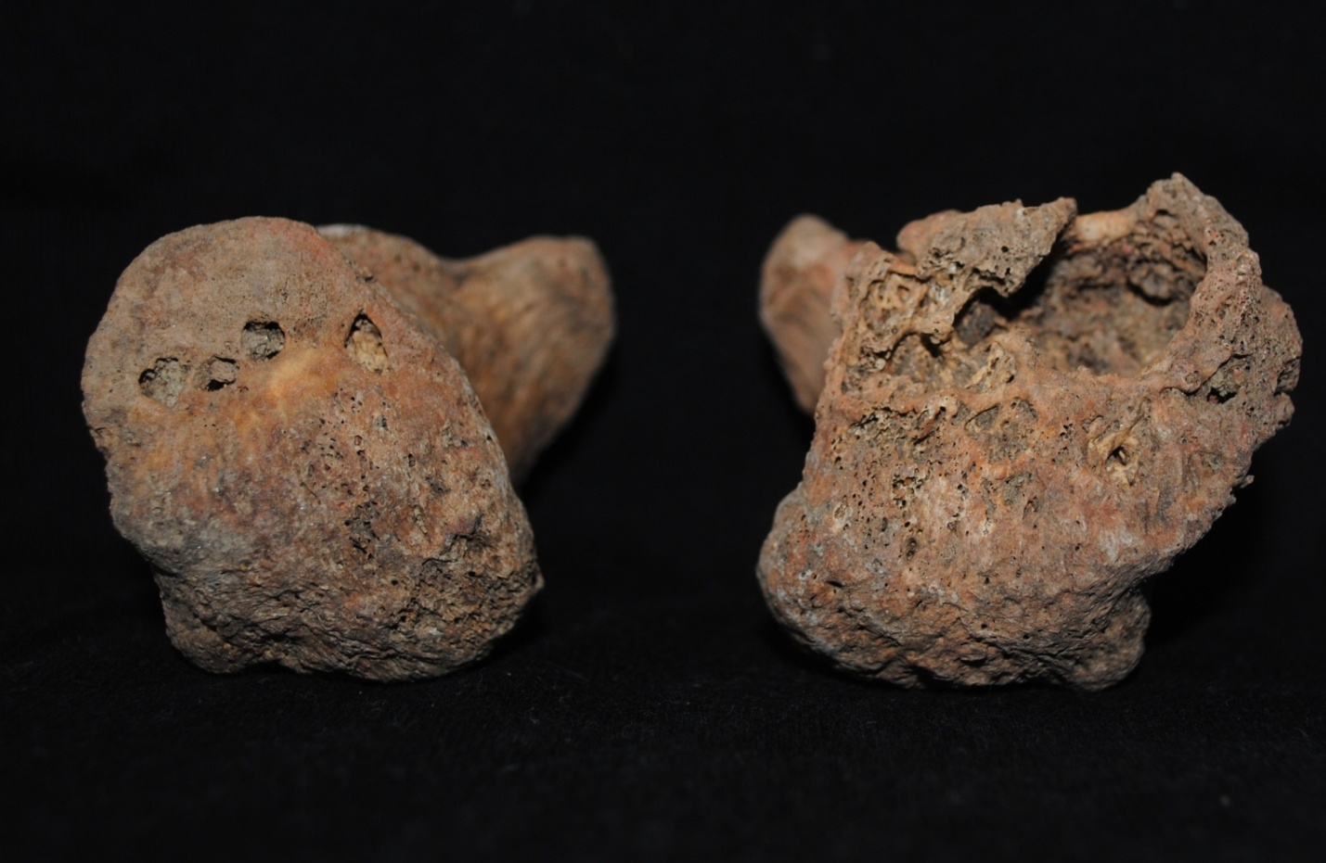
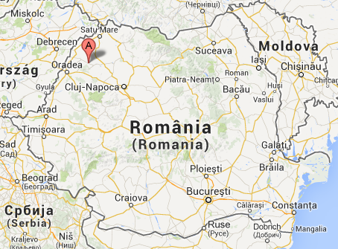
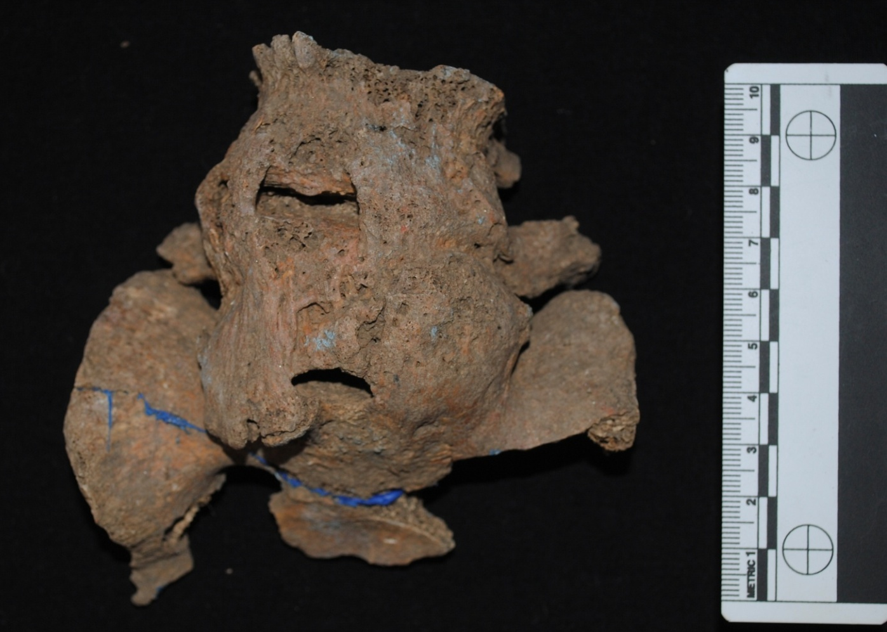
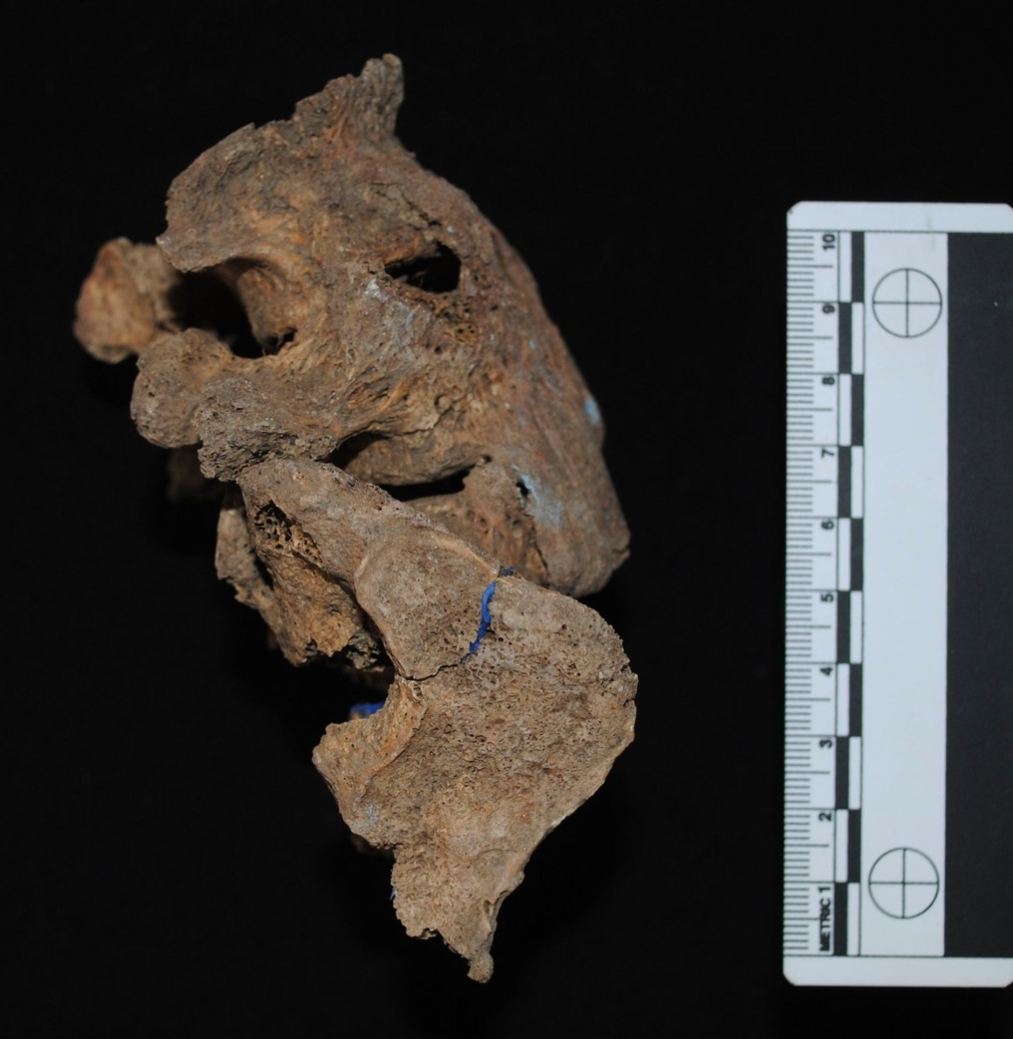
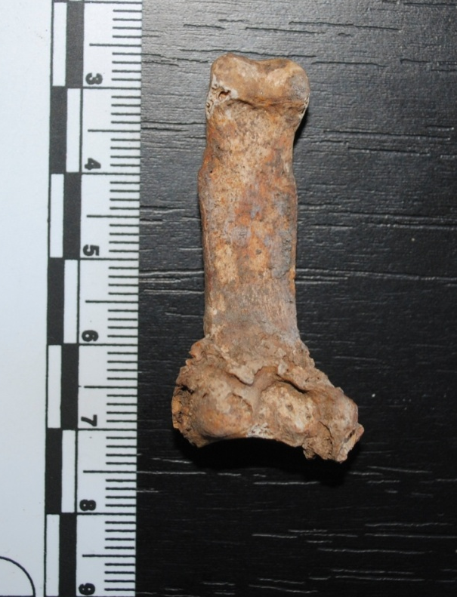
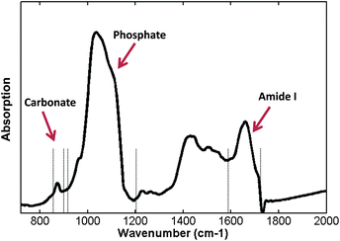
Neolithic diabetes?
Tentative interdisciplinary diagnosis.
Ioana Mihalache^{1,2}, Claudia Radu¹, Beatrice Kelemen^{1,2}
1. Bioarchaeology Laboratory, Molecular Biology Center, Interdisciplinary Research Institute on
Bio & Nano Sciences, Babeș-Bolyai University, Cluj-Napoca, Romania
2. Faculty of Biology and Geology, Babeș-Bolyai University, Cluj Napoca, Romania
Archaeological context
One skeleton from the Suplacu de Barcău archaeological site displays osteopathological changes that indicate diabetes. The skeletal remains were radiocarbon dated to the Neolithic period (3970-3910 B.C.). The Neolithic period was characterized by the transformation of human societies from being hunter-gatherer based to agriculture based. We believe the presence of diabetes in this population is related to the lifestyle and diet changes.
Physical Anthropology Analysis
Pathology
Age at death: 33-45 years.
Sex: Male.
Height: 158-165 cm.
Fig.2. Caries, ante mortem tooth loss
Fig.3. Cribra orbitalia
Fig.4. Lytic lesions on both calcanei
Fig.5. DISH (Diffuse Idiopathic Skeletal Hyperostosis)
Fig. 1. Geographic localtion of Suplacu de Barcău archaeological site. (https://maps.google.ro/)
Fig.6 DISH (Diffuse Idiopathic Skeletal Hyperostosis)
Fig.7. Degenerative joint disease
Considered together, these indicate nutritional stress and, most likely, diabetes mellitus.
Molecular investigations: can we confirm this diagnostic?
This is a very challenging task, because diabetes is a complex disease, which is caused by genetic factors as well as lifestyle and environmental factors.
There are numerous studies that link mutations in a series of genes involved in metabolism with chances of developing type 2 diabetes mellitus. Detection of mutations is made by amplifying and sequencing 100-150 bp fragments around SNPs associated with diabetes.
FT-IR (Fourier Transform Infrared Spectroscopy) : A modified phosphate/carbonate ratio could indicate a modification in the phosphate/calcium balance.
Gene | SNP | Encoded element | Associated with
GCK | rs1799884 C→A C→G | Glucokinase | Maturity onset diabetes
CAPN10 | rs3792267 A→G | Calpain 10 | Insulin resistance
HNF1A | rs1169288 G→T | Hepatocyte nuclear factor 1A | Maturity onset diabetes
HNF4A | rs2144908 A→G | Hepatocyte nuclear factor 4A | Maturity onset diabetes
MTTL1 | 3243 A→G | Mithocondrially encoded tRNA leucine | Maternally inherited diabetes and deafness
ABCC8 | rs725573 G→A | Sulfonylurea receptor 1 | Maturity onset diabetes
Fig. 8. FT-IR Spectra for normal bone (http://www.rsc.org/ej/AN/2010/c0an00500b/c0an00500b-f1.gif)
Table 1. SNPs in genes involved in glucose metabolism and insulin excretion.
Mithocondrial DNA haplogroup: some haplogroups are protective against diabetes.
Conclusion
The aim of this study is an attempt to increase the certainty of a diabetes diagnosis in the case of the Suplacu de Barcău skeleton.
Graph 1. P/C ratio for diabetic and normal femur
REFERENCES
[1] A. Molven, P. R Njølstad, Role of molecular genetics in transforming diagnosis of diabetes mellitus, Expert Rev. Mol. Diagn. 11(3), 313–320 (2011),
[2] D. E. Kelley, J. He, E. V. Menshikova, V. B. Ritov, Dysfunction of Mitochondria in Human Skeletal Muscle in Type 2 Diabetes, Diab. 51: 2944-2950 (2002).
[3] R. Sladek, G. Rocheleau, J. Rung, C. Dina, L. Shen, D. Serre, Ph. Boutin, D. Vincent, A. Belisle, S. Hadjadj, B. Balkau, B. Heude, G. Charpentier, T. J. Hudson, A. Montpetit, A. V. Pshezhetsky, M. Prentki, B. I. Posner, D. J. Balding, D. Meyre, C. Polychronakos, Ph. Froguel, A genome-wide association study identifies novel risk loci for type 2 diabetes, Nature 45, 881-885(2007)
[4] T.L. Dupras , L.J. Williams, H. Willems, C. Peeters, Pathological skeletal remains from ancient Egypt: the earliest case of diabetes mellitus?, Pract Diab Int 27(8), 358–363a (2010)
[5] Y. Song, T. Niu, J.E. Mason, D.J. Kwiatkowski, S. Liu, Are variants in the CAPN10 gene related to risk of type 2 diabetes? A quantitative assessment of population and family-based association studies. Am J Hum Genet., 74(2):208-22, (2004).
[6] Boyar, H., Turan, B., & Severcan, F. (2003). FTIR spectroscopic investigation of mineral structure of streptozotocin induced diabetic rat femur and tibia. Spectroscopy, 17(2,3), 627–633.
Graph 2. Intra-individual variation of P/C ratio
Aknowledgement: This study was supported by funding from the project Genetic Evolution: New Evidences for the Study of Interconnected Structures (GENESIS). A Biomolecular Journey around the Carpathians from Ancient to Medieval Times. (PCCA_1153/2011)

